Slide 1




Extra Session Discussion
18th October, 2024
Introduction to Machine Learning
Prof. Balaraman Ravindran
Professor and Head of the Department
Department of Data Science and Artificial Intelligence
IIT Madras
Ayan Paul
PMRF Research Scholar
IIT Kharagpur

Slide 2


Hierarchical Clustering
In hierarchical clustering, each data point is initially taken into account as a separate cluster, which is subsequently combined with the clusters that are the most similar to form one large cluster that contains all of the data points.
In hierarchical clustering, single-link clustering and complete-link clustering are two different strategies to measure the distance between clusters when merging them during the clustering process.
Single-link Clustering
Complete-link Clustering
In single-link clustering, the distance between two clusters is defined as the shortest distance between any single point in the first cluster and any single point in the second cluster.
In complete-link clustering, the distance between two clusters is defined as the maximum distance between any single point in the first cluster and any single point in the second cluster.
The distance d(A,B) between two clusters A and B is calculated as
The distance d(A,B) between two clusters A and B is calculated as:
Here, d(x,y) represents the distance between points x and y, typically using Euclidean or another distance metric.
Here, d(x,y) represents the distance between points x and y, typically using Euclidean or another distance metric.

Slide 3
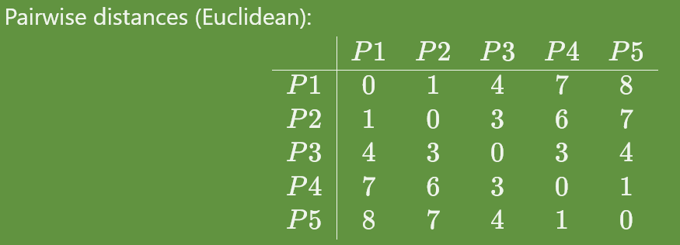
Numerical Comparison of Single-link and Complete-link Clustering
Single-link Clustering Approach
Complete-link Clustering Approach
Step 1: Connect the closest pair of points to form a cluster. Closest pairs are:
d(P1, P2) = 1
d(P4, P5) = 1
Step 2: Connect clusters with single links. This is done by calculating closest distance between points belonging to different cluster
d({P1, P2}, {P3}) = 3
d({P4, P5}, {P3}) = 3
d({P1, P2}, {P3,P4}) = 6
Step 3: Connect the final clusters
Step 1: Connect the closest pair of points to form a cluster. Closest pairs are:
d(P1, P2) = 1
d(P4, P5) = 1
Step 2: Connect clusters with single links. This is done by calculating maximum distance between points belonging to different cluster
d({P1, P2}, {P3}) = 4
d({P4, P5}, {P3}) = 3
d({P1, P2, P3}, {P4,P5}) = 8
Step 3: Connect the final clusters

Slide 4
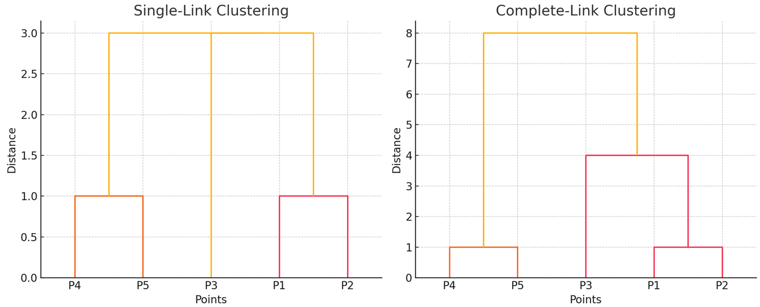

Slide 5

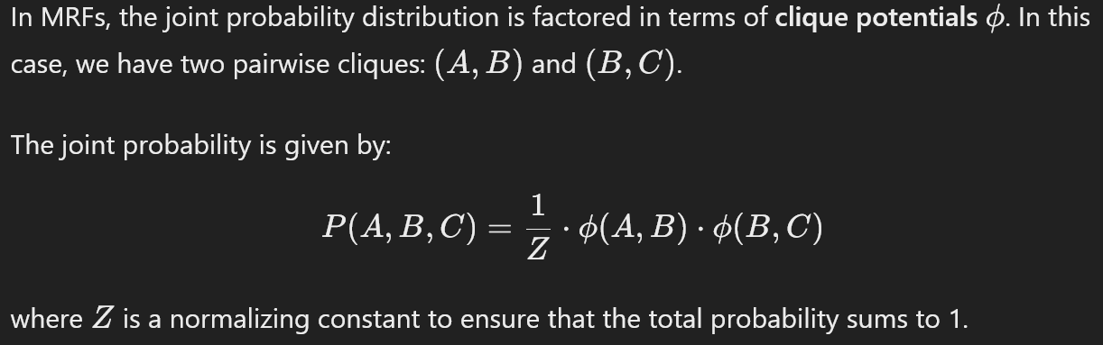
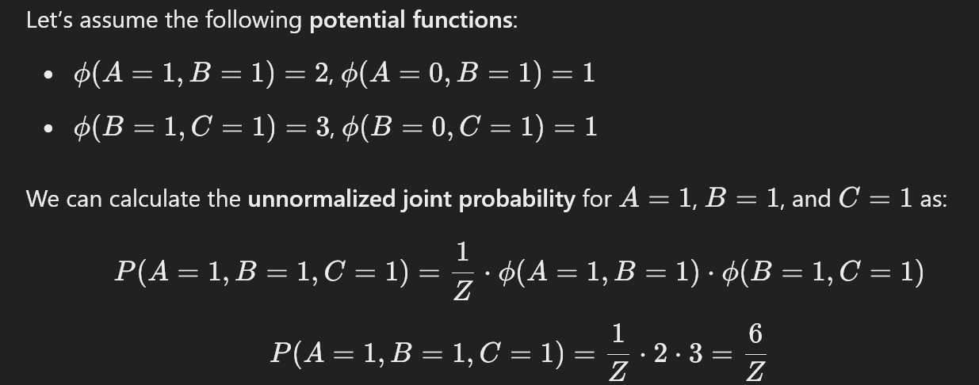
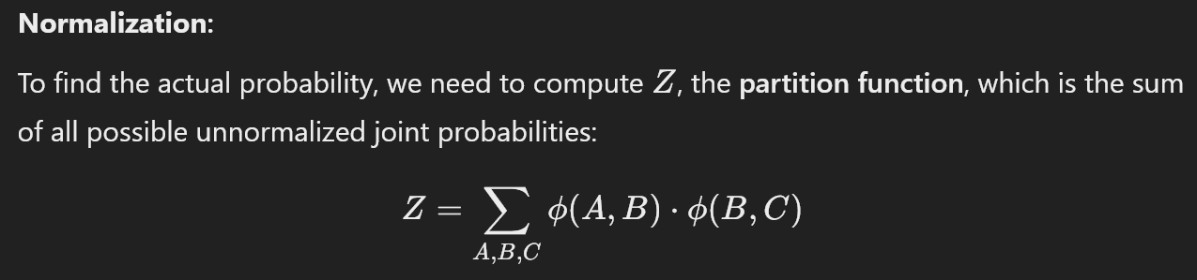
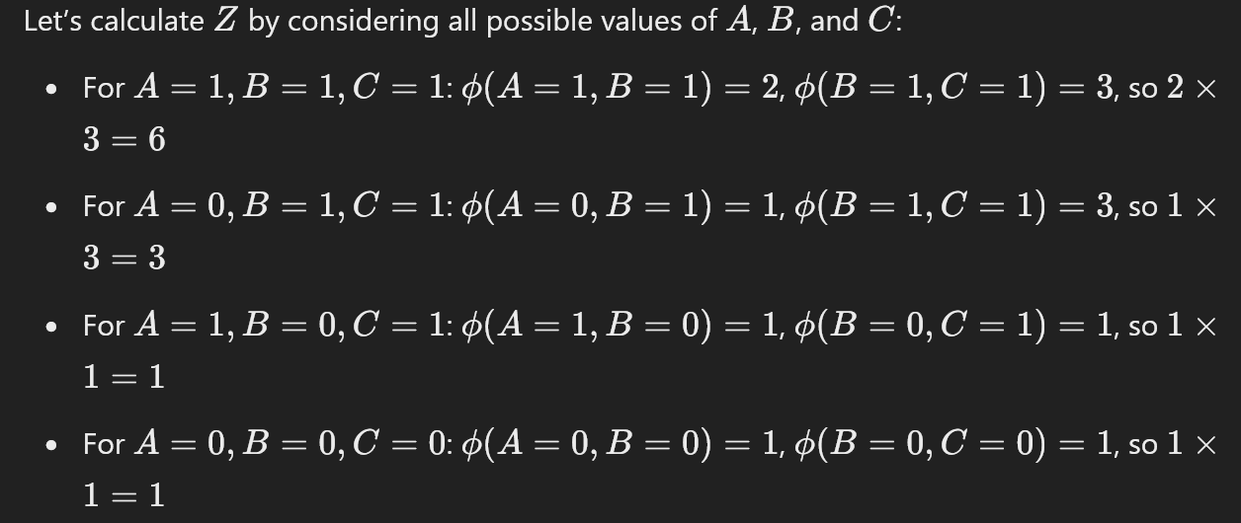
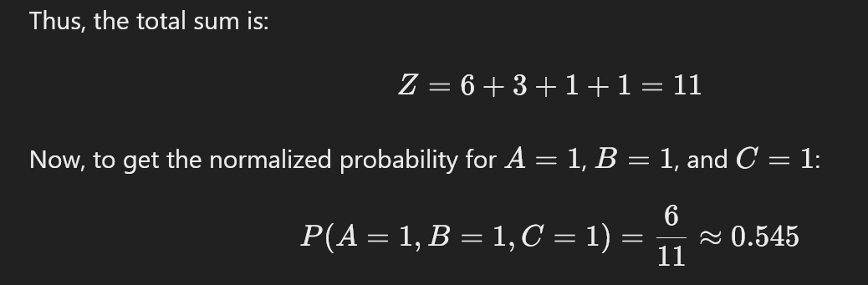
Numerical Approach for Markov Random Field
10
0.6
10

Slide 6
Topics on which Extra Session Questions are based
All important questions covered from Week 1-12

Slide 7
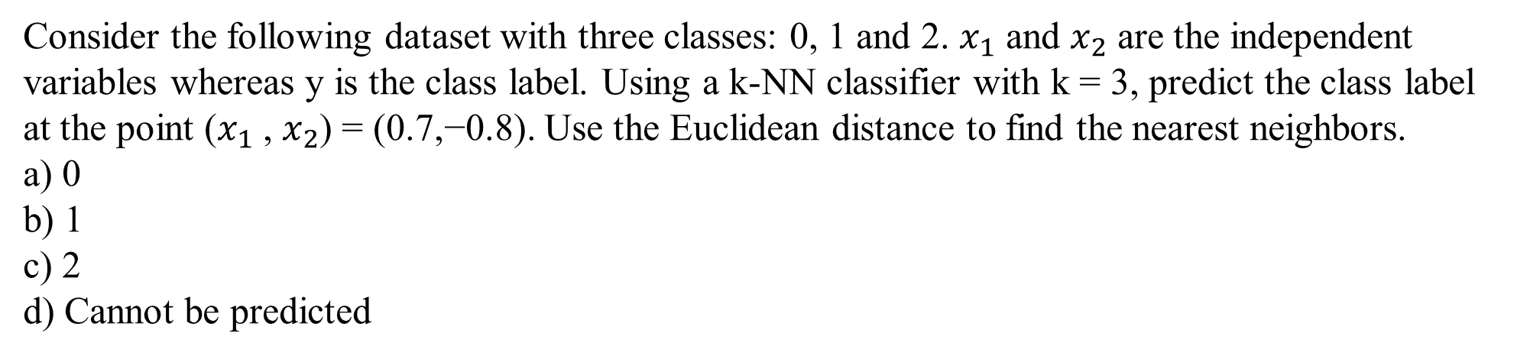
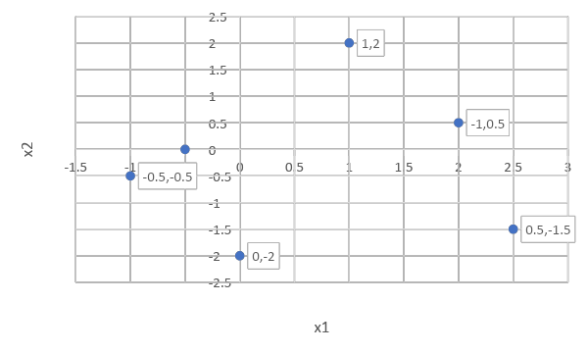
QUESTION 1
x1
 |  | y
-0.5 | 0.0 | 0
2.0 | 0.5 | 0
-1.0 | -0.5 | 1
0.0 | -2.0 | 1
2.5 | -1.5 | 2
1.0 | 2.0 | 2
x2
SOLUTION 1
The 3 nearest neighbors of the point (0.7,−0.8) are (−1.0,−0.5), (−0.5, 0.0) and (0.0,−2.0)
having class labels 1, 0 and 1 respectively. Taking the majority of these labels, we get class 1
as the predicted label.
CORRECT ANSWER 1
b)

Slide 8
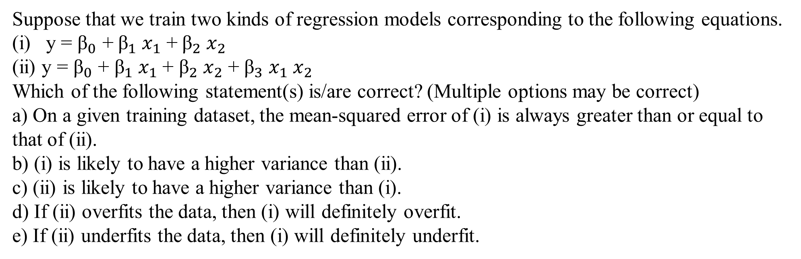
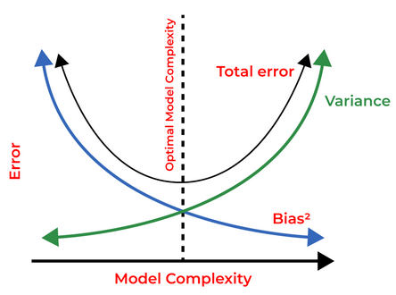
QUESTION 2
SOLUTION 2
Model (ii) is more complex than model (i). So, (ii) will have a lower mean-squared error and higher variance than (i). If a complex model overfits the data, a simpler model may or may not overfit. However, if a complex model underfits the data, a simpler model will definitely underfit.
CORRECT ANSWER 10
a), c), e)

Slide 9
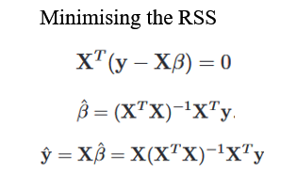
QUESTION 3
Consider the following 4 training examples:
We want to learn a function f(x) = ax+b which is parametrized by (a, b). Using squared error
as the loss function, which of the following parameters would you use to model this function.
a) (1,1)
b) (1,2)
c) (2,1)
d) (2,2)
x | y
-1 | 0.0319
0 | 0.8692
1 | 1.9566
2 | 3.0343
SOLUTION 3
The line y = x + 1 is the one with minimum squared error out of all the four proposed.
CORRECT ANSWER 3
a)

Slide 10
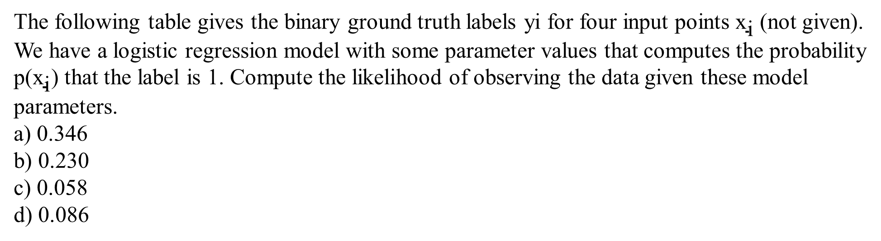

QUESTION 4
Y | 1 | 1 | 0 | 1
 | 0.8 | 0.4 | 0.2 | 0.9
p(x)
SOLUTION 4
Apply the equation
CORRECT ANSWER 4
b)

Slide 11
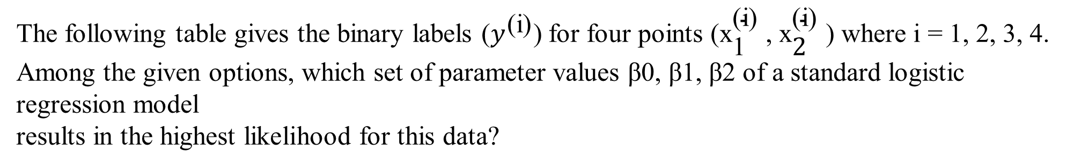

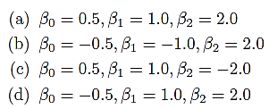
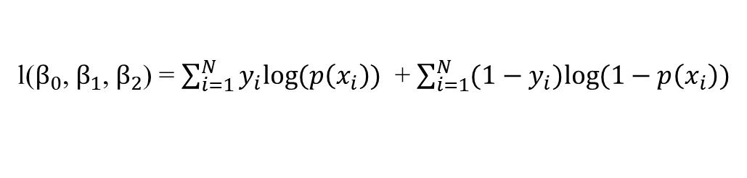
QUESTION 5
x1 | x2 | y
0.4 | -0.2 | 1
0.6 | -0.5 | 1
-0.3 | 0.8 | 0
-0.7 | 0.5 | 0
SOLUTION 5
For each option, first compute the probabilities and then compute the log-likelihood using the following equation.
CORRECT ANSWER 5
c)

Slide 12
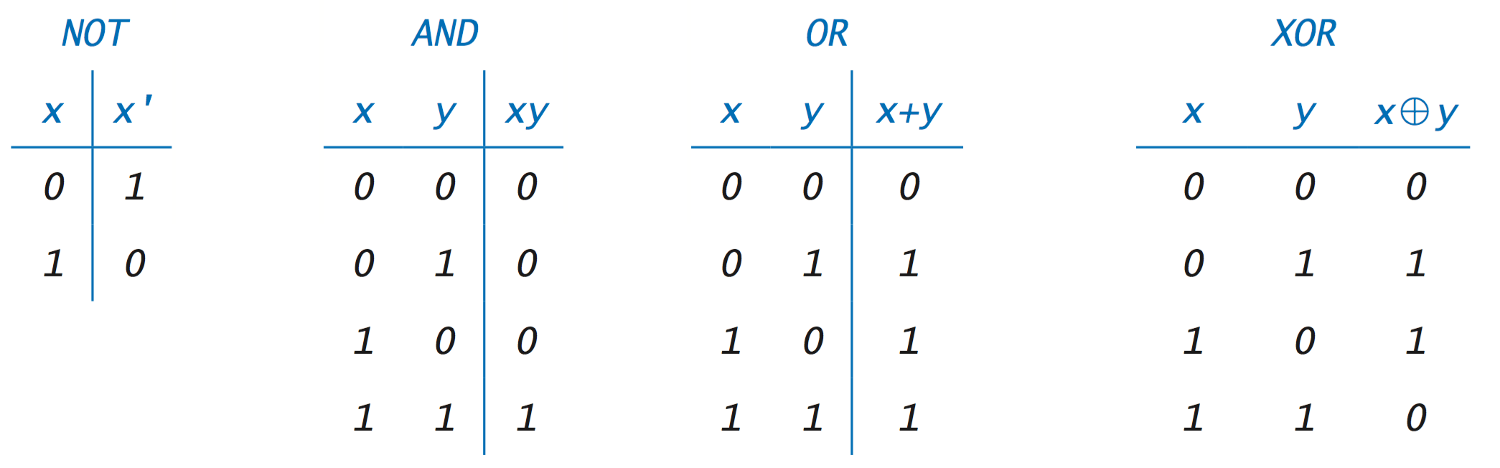
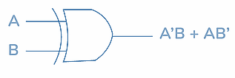
QUESTION 6
Which of the following is/are true about the Perceptron classifier?
a) It can learn a OR function
b) It can learn a AND function
c) It can learn XOR function
d) For a linearly separable problem, there exists some initialization of the weights which might lead to non-convergent cases.
SOLUTION 6
OR and AND are linear functions, hence can be learnt by perceptron. XOR is non linear function which cannot be learnt by a perceptron learning algorithm which can learn only linear functions.
We can also prove that the algorithm always converges to a separating hyperplane if it exists. Hence (d) is false.
CORRECT ANSWER 6
a), b)

Slide 13
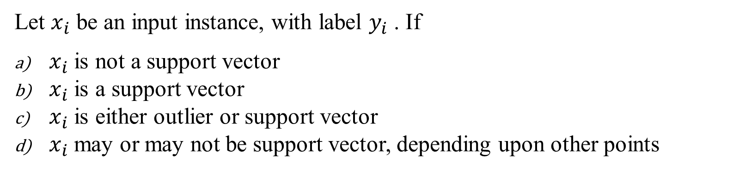
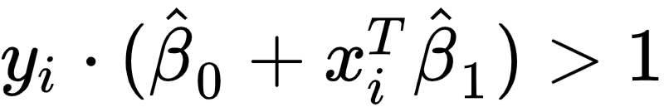
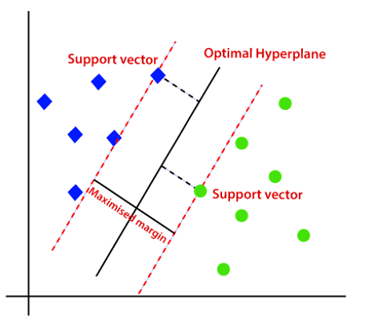
QUESTION 7
SOLUTION 7
CORRECT ANSWER 7
a)

Slide 14
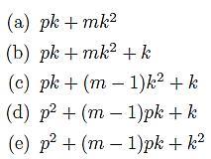
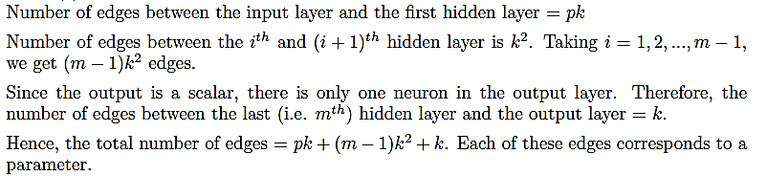
QUESTION 8
Consider a feedforward neural network that performs regression on a p-dimensional input to
produce a scalar output. It has m hidden layers and each of these layers has k hidden units.
What is the total number of trainable parameters in the network? Ignore the bias terms.
SOLUTION 8
CORRECT ANSWER 8
c)

Slide 15
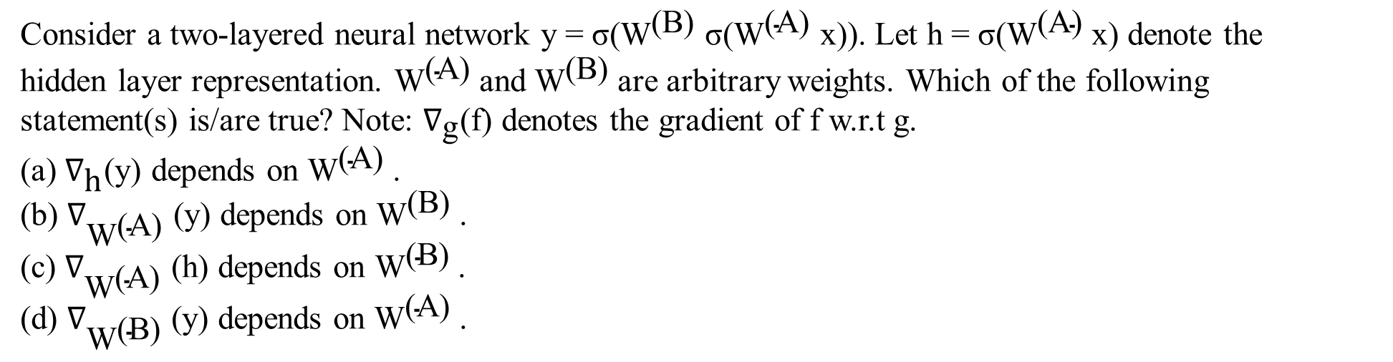
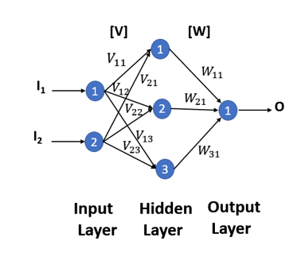
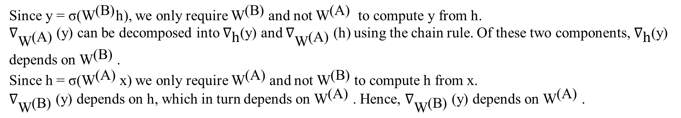
QUESTION 9
A
h
B
x
y
SOLUTION 9
CORRECT ANSWER 9
b), d)

Slide 16
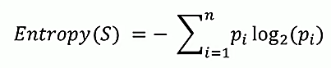
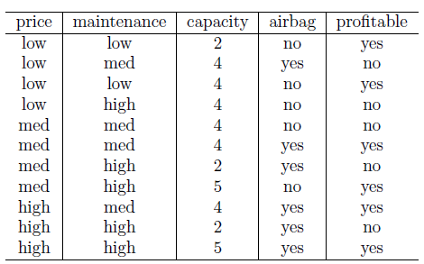
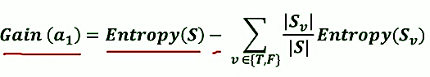
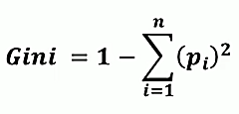
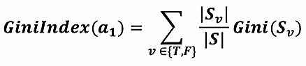
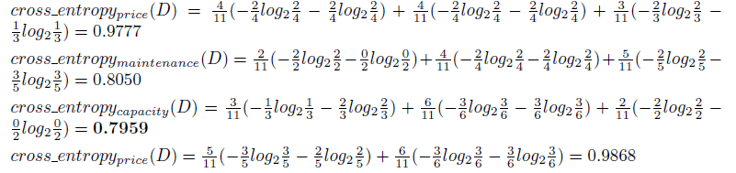
QUESTION 10
Consider the following data set:
Considering ‘profitable’ as the binary values attribute we are trying to predict, which of the attributes would you select as the root in a decision tree with multi-way splits using the cross-entropy impurity measure?
a) price
b) maintenance
c) capacity
d) airbag
SOLUTION 10
CORRECT ANSWER 10
c)

Slide 17
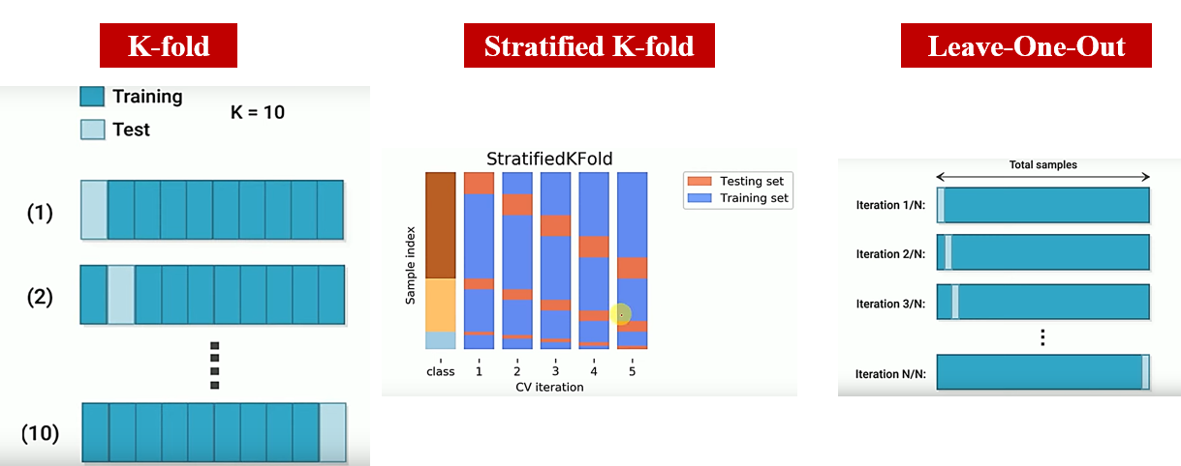
QUESTION 11
We have a dataset with 1000 samples and 5 classes for classification. What would be the training size for a 20 fold cross validation?
(a) 50
(b) 200
(c) 800
(d) 950
SOLUTION 11
The training size does not depend on the number of classes. 20 fold means that the dataset will be divided equally 20 and 19 of those will be used for training which results in the answer to be 950.
CORRECT ANSWER 11
d)

Slide 18
QUESTION 12
Suppose we have a classification dataset comprising of 2 classes A and B with 100 and 50
samples respectively. Suppose we use stratified sampling to split the data into train and test
sets. Which of the following train-test splits would be appropriate?
a) Train- {A : 80 samples,B : 30 samples}, Test- {A : 20 samples,B : 20 samples}
b) Train- {A : 20 samples,B : 20 samples}, Test- {A : 80 samples,B : 30 samples}
c) Train- {A : 80 samples,B : 40 samples}, Test- {A : 20 samples,B : 10 samples}
d) Train- {A : 20 samples,B : 10 samples}, Test- {A : 80 samples,B : 40 samples}
SOLUTION 12
In stratified sampling, the train and test sets have the same class proportions as the original dataset. Also, the train set is generally chosen to be larger than the test set.
Options (c) and (d) preserve the class proportion in the original dataset. Of these two, (c) has a larger training set while (d) has a larger test set. Hence, (c) is the right option.
CORRECT ANSWER 12
c)

Slide 19
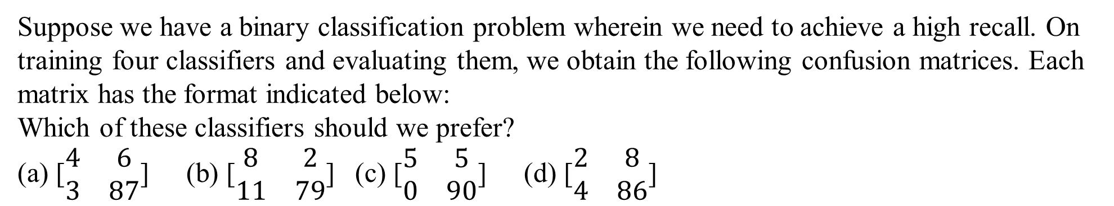
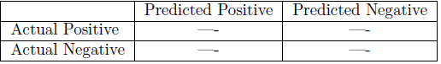
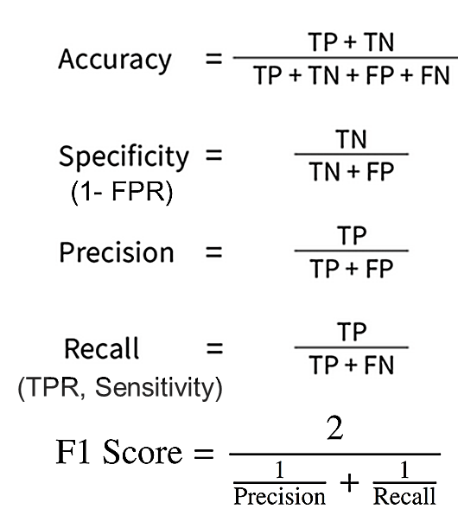
QUESTION 13
SOLUTION 13
The recall is computed as TP/TP+FN .
For option (b), recall = 8/8+2 = 0.8, which is the maximum among all the options. Similarly, we can compute it for the other options and verify that option (b) has the highest recall.
CORRECT ANSWER 13
b)

Slide 20
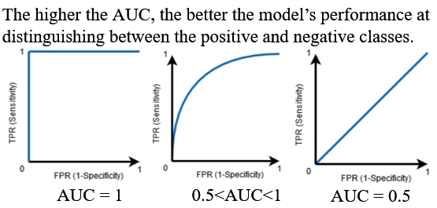
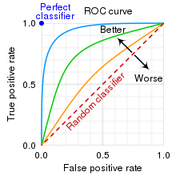
QUESTION 14
In a ROC curve, what does the diagonal line represent?
The perfect classifier
Random guessing
Trade-off between sensitivity and specificity
The ideal threshold for classification
SOLUTION 14
When AUC=0.5, then the classifier is not able to distinguish between Positive and Negative class points. Meaning that the classifier either predicts a random class or a constant class for all the data points.
CORRECT ANSWER 14
b)

Slide 21
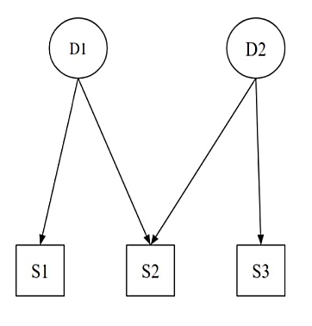
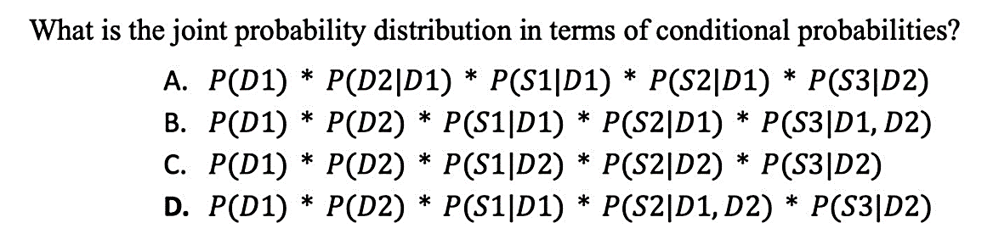
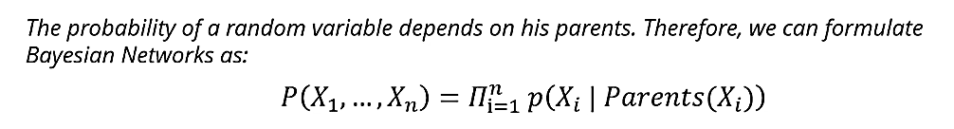
QUESTION 15
SOLUTION 15
From the figure, we can see that D1 and D2 are not dependent on any variable as they don’t have any incoming directed edges. S1 has an incoming edge from D1, hence S1 depends on D1. S2 has 2 incoming edges from D1 and D2, hence S2 depends on D1 and D2. S3 has an incoming edge from D2, S3 depends on D2. Hence, (D) is the answer.
CORRECT ANSWER 15
d)

Slide 22
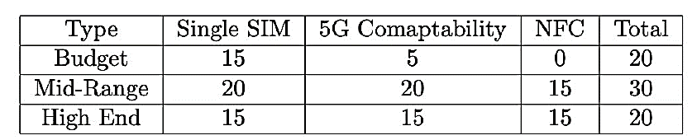
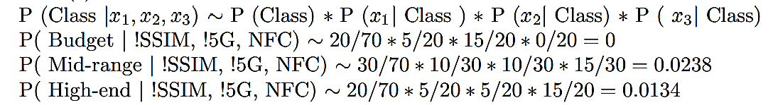
QUESTION 16
Consider the following data for 20 budget phones, 30 mid-range phones, and 20 high-end phones:
Consider a phone with 2 SIM card slots and NFC but no 5G compatibility. Calculate the probabilities of this phone being a budget phone, a mid-range phone, and a high-end phone using the Naive Bayes method. The correct ordering of the phone type from the highest to the lowest probability is?
(a) Budget, Mid-Range, High End
(b) Budget, High End, Mid-Range
(c) Mid-Range, High End, Budget
(d) High End, Mid-Range, Budget
SOLUTION 16
CORRECT ANSWER 16
c)

Slide 23
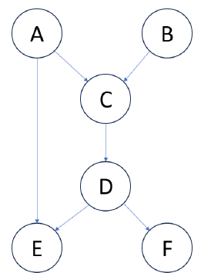
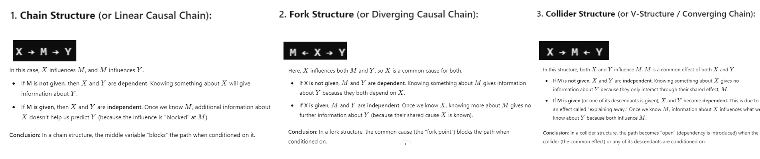
QUESTION 17
Consider the Bayesian network given below. Which of the following statement(s) is/are correct?
(a) B is independent of F, given D.
(b) A is independent of E, given C.
(c) E and F are not independent, given D.
(d) A and B are not independent, given D.
SOLUTION 17
There is only one path from B to F, which passes through C. If C is given, then B and F are independent.
There is an edge from A to E. So, A and E are not independent even if C is given.
E and F are children of D. Hence, they are independent if D is given.
D is a descendant of both A and B. Hence, they are not independent if D is given.
CORRECT ANSWER 17
a), d)

Slide 24
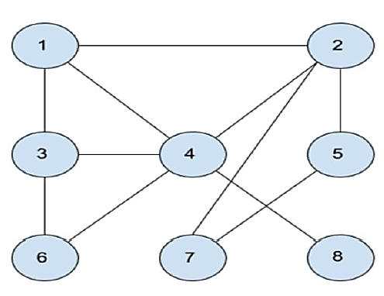
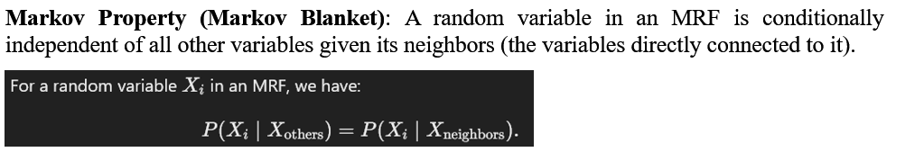
QUESTION 18
In the Markov network given in the figure, two students make
the following claims
• Manish claims variable “1” is dependent on variable “7” given
variable “2”.
• Trina claims variable “2” is independent of variable “6” given
variable “3”.
Which of the following is true?
(a) Both the students are correct.
(b) Trina is incorrect and Manish is correct.
(c) Trina is correct and Manish is incorrect.
(d) Both the students are incorrect.
(e) Insufficient information to make any conclusion.
SOLUTION 18
Statement 1: If we block 2 then there’s no path between 1 and 7. Therefore 1 and 7 is independent given 2. ⇒ Manish is incorrect
Statement 2: If we block 3 then also there is a path to reach from 2 to 6 via 4. Therefore 2 is dependent on 6 given 3. ⇒ Trina is incorrect
CORRECT ANSWER 18
d)

Slide 25
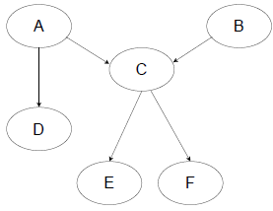

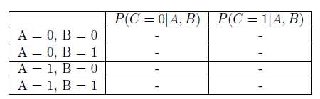

QUESTION 19
In the Bayesian Network, assume that every variable is binary. What is the number of independent parameters required to represent all the probability tables for the distribution?
(a) 8 (b) 12 (c) 16 (d) 24 (e) 36
SOLUTION 19
To fully specify the distribution, we would need tables corresponding to P(A), P(B), P(C|A,B), P(D|A), P(E|C), P(F|C).The table for P(A) would appear as follows. It has 1 independent parameter since P(A = 1) can be determined given P(A = 0). The table structure is similar for P(B), which also has 1 parameter.
The table for P(C|A,B) would appear as follows. It has 4 independent parameters, where each parameter corresponds to a row. Given one of the entries in a row, we can determine the other one.
The table for P(D|A) would appear as follows. It has 2 independent parameters, where each parameter corresponds to a row. Given one of the entries in a row, we can determine the other one. Since P(E|C) and P(F|C) have a similar structure, they also have 2 independent parameters each.
Hence, the total number of independent parameters is 1 + 1 + 4 + 2 + 2 + 2 = 12
CORRECT ANSWER 19
b)

Slide 26
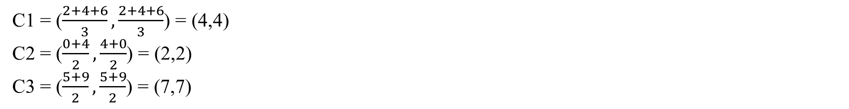
QUESTION 20
Assume you want to cluster 7 observations into 3 clusters using the K-Means clustering algorithm. After the first iteration, clusters C1, C2, C3 have following observations:
C1: {(2,2), (4,4), (6,6)}
C2: {(0,4), (4,0)}
C3: {(5,5), (9,9)}
What will be the cluster centroids if you want to proceed with the second iteration?
C1: (4,4), C2: (2,2), C3: (7,7)
C1: (6,6), C2: (4,4), C3: (9,9)
C1: (2,2), C2: (0,0), C3: (5,5)
None of these
SOLUTION 20
CORRECT ANSWER 20
a)

Slide 27


QUESTION 21
The pairwise distance between 6 points is given below. Which of the option shows the hierarchy of clusters created by single link clustering algorithm?
SOLUTION 2
Step 1: Connect closest pair of points. Closest pairs are:
d(P3, P4) = 1
d(P5, P6) = 2
d(P1, P2) = 3
Step 2: Connect clusters with single link. The cluster pair to combine is bolded:
d({P1, P2}, {P3, P4}) = 8
d({P1, P2}, {P5, P6}) = 4
d({P5, P6}, {P3, P4}) = 6
Step 3: Connect the final 2 clusters
CORRECT ANSWER 21
b)

Slide 28


QUESTION 22
SOLUTION 22
In real life, many datasets can be modeled by Gaussian Distribution.
The Gaussian Mixture Model intuitively assumes that clusters originate from different Gaussian distributions, modeling the dataset as a mixture of these distributions—this forms the core concept of the model.
Suppose there are K clusters, the probability density is defined as a linear function of densities of all these K distributions, i.e.
The clusters are not sampled from a gaussian distribution. However, increasing k (number of clusters) we can fit the model
CORRECT ANSWER 22
b), c)

Slide 29

QUESTION 23
Suppose we have a Gaussian mixture model of 3-dimensional data with 4 Gaussians, and we use a model with full covariance matrices. How many parameters are in the model?
30
40
50
60
SOLUTION 23
CORRECT ANSWER 23
b)

Slide 30

QUESTION 24
Statement 1: Empirical error is always greater than generalisation error.
Statement 2: Training data and test data have different underlying(true) distributions.
Choose the correct option:
(a) Statement 1 is true. Statement 2 is true. Statement 2 is the correct reason for statement 1.
(b) Statement 1 is true. Statement 2 is true. Statement 2 is not the correct reason for statement 1.
(c) Statement 1 is true. Statement 2 is false.
(d) Both statements are false.
SOLUTION 24
Empirical error can be greater than or less than generalisation error. In fact, it is typically less than generalisation error since the model tends to perform better on the data it has seen during training.
CORRECT ANSWER 24
d)

Slide 31
QUESTION 25
You want to create a self-driving car software. In the context of the standard Reinforcement Learning framework, what would you classify as the state and actions? Note that your system does not have access to previous states.
a. State-(Current steering wheel position, Current pedal positions, Current speed) Actions-(Turn the steering wheel, Press pedals)
b. State-(Current steering wheel position, Current pedal positions, Current acceleration) Actions-(Turn the steering wheel, Press pedals)
c. State-(Current steering wheel position, Current pedal positions, Current speed) Actions-(Change direction, Change speed)
d. State-(Current steering wheel position, Current pedal positions, Current acceleration) Actions-(Change direction, Change speed)
SOLUTION 25
State-(Current steering wheel position, Current pedal positions, Current speed) Actions-(Turn the steering wheel, Press pedals)
CORRECT ANSWER 25
a)

Slide 32


Contact me: https://sites.google.com/view/ayans-agribot/home

